Slide 1
Employee Data Analysis Using Excel
STUDENT NAME : M .GAYATHRI
REGISTER NUMBER: 312215820 (ANUM1621312215820)
DEPARTMENT: B.com Accounting and Finance
COLLEGE: Shri Shankarlal Sundarbai Shasun Jain College For Women

Slide 2
Employees Data Analysis Using Excel
PROJECT TITLE

Slide 3
AGENDA
Project Statement
Project Overview
End users
Our solution and propositon
Dataset Description
Modelling Approach
Results and discussion
Conclusion

Slide 4
PROBLEM STATEMENT
Performance Insights : Lack of understanding of employee perfomance metrics.
Turnover analysis : Do not have a clear understanding of employee turnover trends.
IMPACT
Impacting the ability to implement effective retention strategies.

Slide 5
PROJECT OVERVIEW
OBJECTIVE
Focusing on performance evaluation,turnover trends.
To utilize Excel's forecasting tools.
SCOPE
To analyze employee performance metrics
To examine turnover rates and identify patterns.

Slide 6
END USERS
Human Resource Managers
Department Heads and Team Leaders
Executives and Senior Leadership
Employee Relation Specialist
Data Analysts and Business Intelligence
They rely on the analaysis to make effective decisions.

Slide 7
OUR SOLUTION AND PROPOSITION
ACTION :
Analyze performance data to identify high and low performance.
BENEFIT :
Helps in optimizing effective management,improving employee engagement and to achieve diversity goals.
COMPONENTS :
1.Excel features and tools
2.Graphs , charts and dashboards

Slide 8
DATASET DESCRIPTION
Employee ID
Employee first name
Last name
Employee position
Business unit
Gender code
Performance score
Employee Status

Slide 9
THE "WOW" IN OUR SOLUTION
Interactive dashboards
Feature:Utilization of advanced excel tools such as pivot tables,regression analysis and forecasting functions.
Benefit:User friendly interfaces for exploring different aspects of employee data
User – Friendly Interface
Feature:Intutive excel features and templates designed for ease to use
Benefit:Simplifies the data analysis process and ensures that even users with basic excel knowledge can effectively utitlize the tool.

Slide 10
MODELLING APPROACH
DATA PREPARATION:
. Data cleaning – Identify missing values and correct any errors
. Data Structuring – Organize data into structured tables.
Techniques used for analysis :
. Descriptive analysis – usage of pivot tables ,charts and graphs
.Correlation analysis – Excel's correlation function and scatter plots
. Descriptive Statistics – Mean,Median and Standard deviation

Slide 11
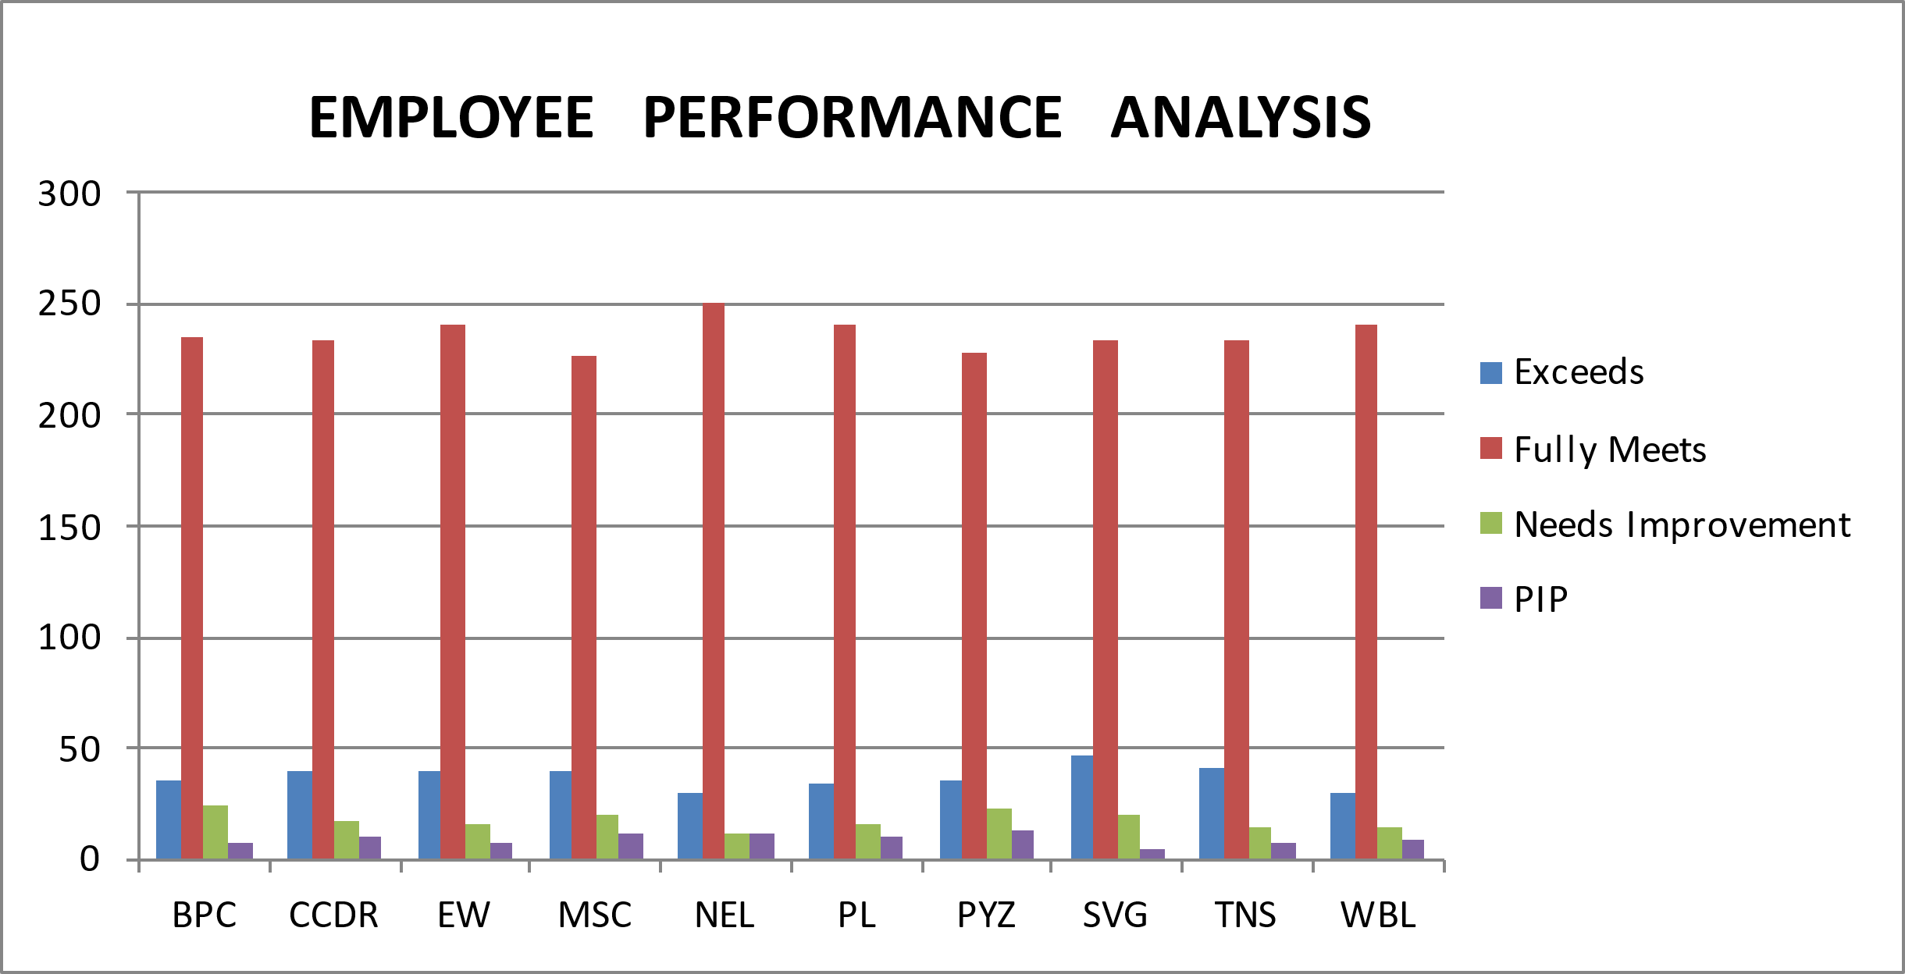
RESULTS

Slide 12
CONCLUSIONS
The analysis provides actionable insights into employee performance and turnover.Charts and Visualization reveal significant trends such as patterns,performance.
SUMMARY
The comprehensive analysis of employee data using excel has provided valuable insights into performance metrics,workfroce trends.The organisation can improve operational efficiency,employee satisfaction,and overall business outcomes.

